Slide 1

WPDD202: Webpage Design & Development
Version 2 – 18th December 2022

Slide 2
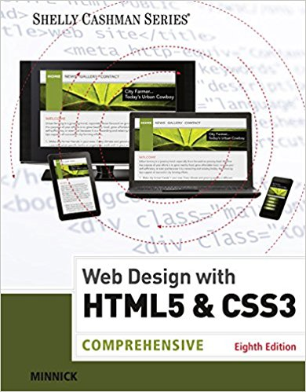
Resource Material
Web Design with HTML & CSS3: Comprehensive, 8th Edition
Jessica Minnick; Lisa Friedrichsen
ISBN-10: 1305578163 | ISBN-13: 9781305578166 © 2017
Cengage Learning Australia

Slide 3
Chapter 3
Enhancing a Website with Links and Images

Slide 4
Chapter Objectives
Describe types of hyperlinks
Create relative links, absolute links, email links, and telephone links
Describe image file formats
Describe the image tag and its attributes
Add images to a website
Explain div elements and attributes

Slide 5
Chapter Objectives (continued)
Use a div element to mark a page division
Define the class attribute
Describe and use HTML heading tags
Describe the types of lists in an HTML document
Create an unordered list and a description list
Test and validate links on a webpage

Slide 6
Adding Links to a Webpage
Hyperlink – It is a link on a webpage that allows users to navigate a website and move from one page to another
Link – It is text, an image, or other webpage content that visitors tap or click to instruct the browser to go to a location in a file
Text link – Also known as hypertext link. When text is coded as a hyperlink, it appears as underlined text in a color different from the rest of the webpage text
Image link – It is used to indicate an image as a link and some websites display a border around the image

Slide 7
Anchor element
It is used to create a hyperlink on a webpage
The <a> and </a> are the start and the end tags
Include the href attribute in the starting anchor tag to identify the webpage, email address, file, telephone number, or other content to access
The value of the href attribute is the content for a link

Slide 8
Relative link
It is a hyperlink that links to other webpages within the same website
It is created by using an anchor tag with an href attribute that designates the file name of the webpage or the path and the file name of the webpage

Slide 9
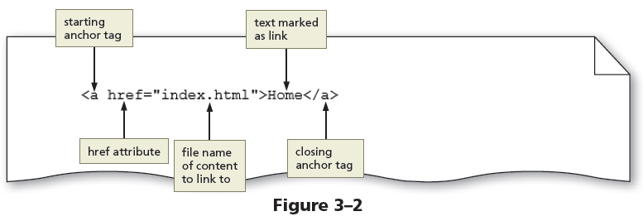
Relative link (continued)
The Figure 3-2 shows an example of a relative link

Slide 10
Absolute link
It is a hyperlink that links to other webpages outside of a website
It is created using an anchor element with an href attribute that designates a website URL

Slide 11
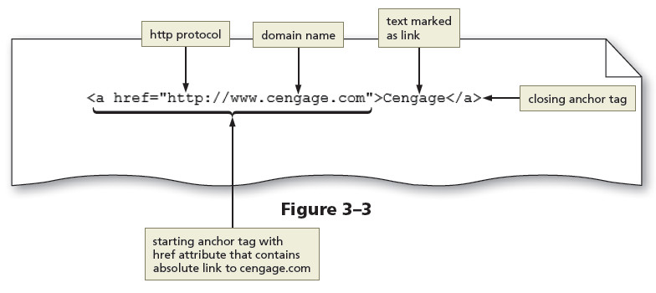
Absolute link (continued)
The Figure 3-3 shows an example of an absolute link

Slide 12
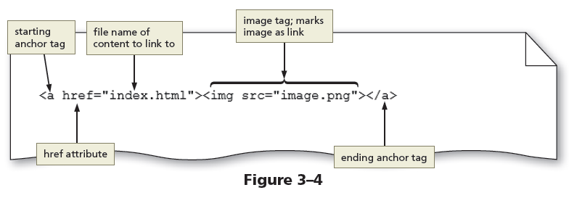
Image link
Images can be used to link to another page within the site, another website, an email address, or a telephone number

Slide 13
Email link
It is a hyperlink that links to an email address
Use anchor elements to link to an email address by including the href attribute followed by "mailto:" and then the email address

Slide 14
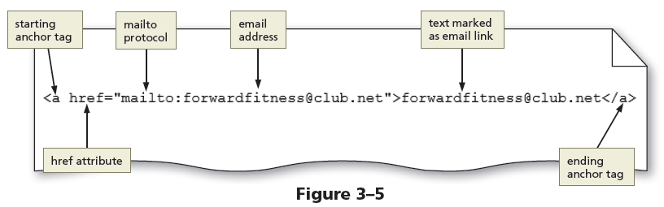
Email link (continued)
The Figure 3-5 shows an example of an email link

Slide 15
Telephone link
It is a hyperlink that links to a telephone number
Use an anchor element to link to a telephone number by including the href attribute, followed by "tel:+1number" where +1 is the international dialing prefix and number is the phone number

Slide 16
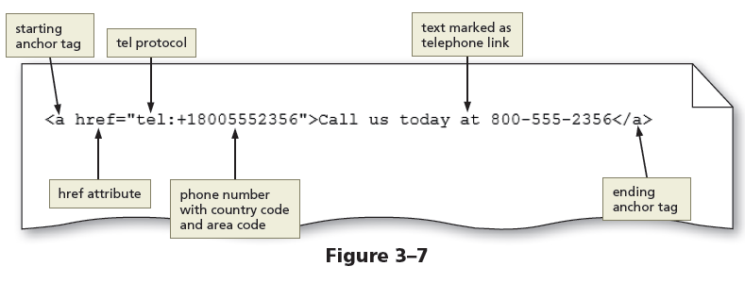
Telephone link (continued)
The Figure 3-7 shows an example of a telephone link

Slide 17
Adding Images to a Website
Images include photos, drawings, diagrams, charts, and other graphics that convey visual information
Images should support the purpose of the webpage or illustrate the content

Slide 18
Image File Formats
Image files are created in several formats such as:
Graphics Interchange Format (GIF) – It supports transparency and frame animation
Lossless compression – To compress an image, GIF uses this technique to maintain the file’s color information
Portable Network Graphics (PNG) – It supports transparency, but not animation

Slide 19
Image File Formats (continued)
Joint Photographic Experts Group (JPG or JPEG) – It is a standard file format for digital photos
Lossy compression – To reduce file size, this technique is used to discard some of the color information in the image
Scalable Vector Graphics (SVG) – It is a format that uses markup language to create two-dimensional graphics, images, and animations

Slide 20
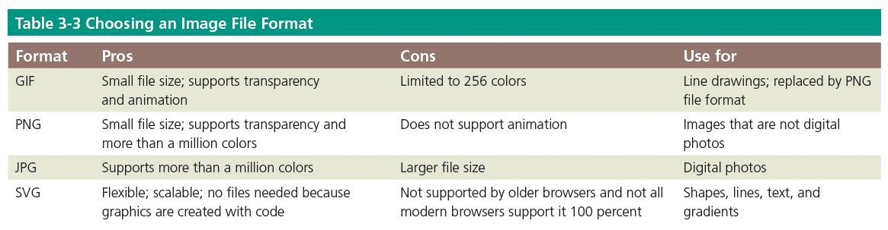
Image File Formats (continued)

Slide 21
Image Dimensions and File Size
Pixel – It is the smallest element of light or color on a device displaying images
The common resolution for laptops is 1366 x 768 pixels
The disadvantage of an image with a high resolution is that it also has a large file size
Use graphic or photo editors to optimize an image with a large file size to reduce its file size and load time

Slide 22
Image Tag and Its Attributes
<img> – The image tag is an empty HTML tag used to add an image to a webpage
The image tag includes attributes such as:
src – It identifies the image file being inserted
alt – It specifies alternate text in case the image cannot be displayed in a browser
height – It defines the height of an image in pixels
width – It defines the width of an image in pixels

Slide 23
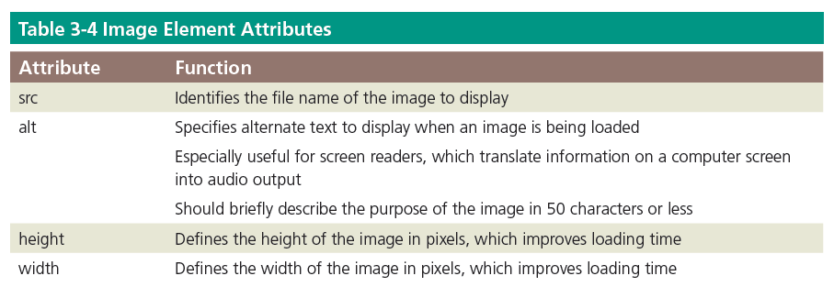
Image Tag and Its Attributes (continued)

Slide 24
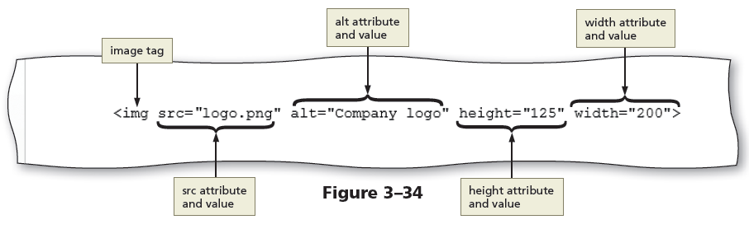
Image Tag and Its Attributes (continued)
The Figure 3-34 shows an example of an image tag with attributes

Slide 25
Div element
Div element defines an area or a division in a webpage
It uses the <div> and </div> tags
It can be used within the main element to further divide the primary content area into separate sections

Slide 26
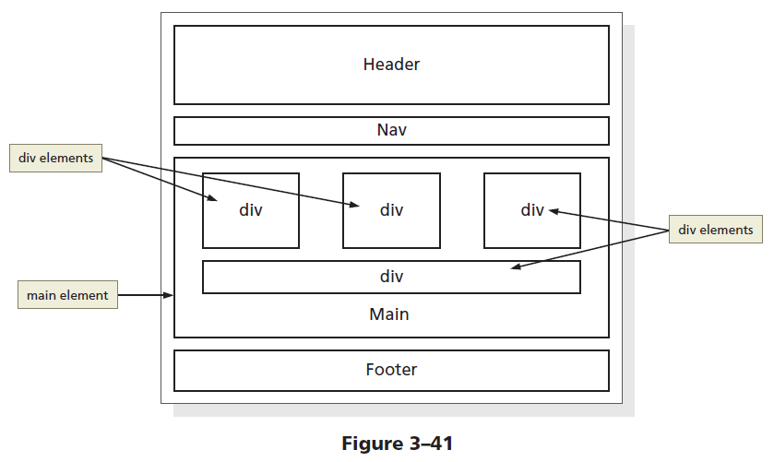
Div element (continued)
The Figure 3-41 shows a wireframe with four div elements inside the main element

Slide 27
Div attributes
Div elements have attributes that provide information about the element
The id is a div attribute which identifies a unique area on a webpage and distinguishes it from other page divisions

Slide 28
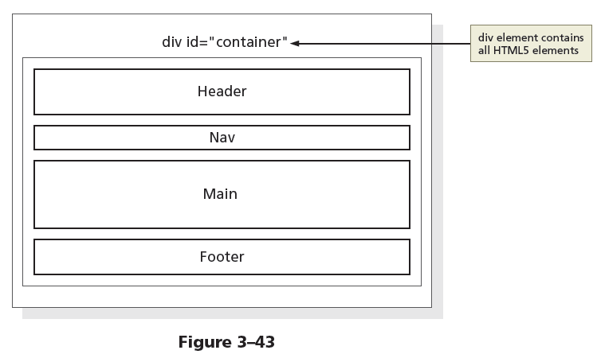
Div attributes (continued)
The Figure 3-43 shows the revised wireframe with the div element and id attribute value defined as container

Slide 29
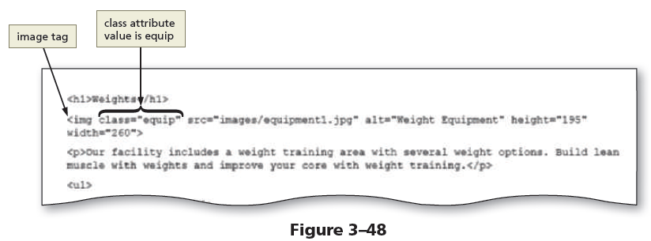
Class Attributes
A class attribute name can be applied to more than one div or other HTML element on a webpage
The Figure 3-48 shows an example of a class attribute used within an image tag

Slide 30
Div id and class
ids are unique
Each element can have only one id
Each page can have only one element with that id
classes are NOT unique
You can use the same class on multiple elements.
You can use multiple classes on the same element.

Slide 31
Adding Headings and Lists
Heading elements –Provide a title or heading before a paragraph of text or section of a page
Heading levels – There are 6 levels of headings (h1, h2, h3, h4, h5, and h6), with level 1 being the most important and level 6 the least

Slide 32
Adding Headings and Lists (continued)
List – It structures text into an itemized format
The different types of lists are:
Unordered list
It displays each item of information in no specific sequence
The <ul> and </ul> are the start and end tags for an unordered list
<li> and </li> are the start and end list item tags

Slide 33
Adding Headings and Lists (continued)
The following code creates a bulleted list of two items:
<ul>
<li>First item</li>
<li>Second item</li>
</ul>

Slide 34
Adding Headings and Lists (continued )
Ordered list
It displays information in a series using numbers or letters
The <ol> and </ol> are the start and end tags for an ordered list
<li> and </li> are the start and end list item tags
The following code creates a numbered list of two items:
<ol>
<li>First item</li>
<li>Second item</li>
</ol>

Slide 35
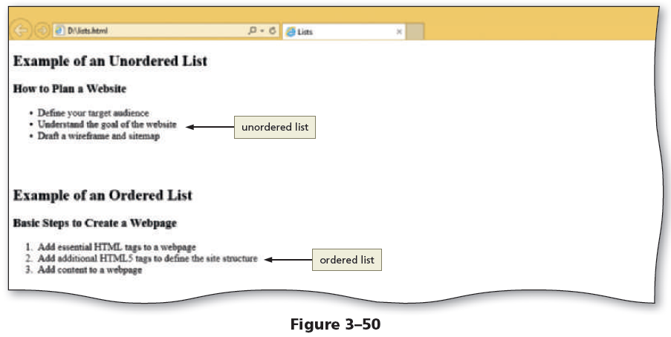
Adding Headings and Lists (continued )
The Figure 3-50 shows a webpage with an unordered and an ordered list

Slide 36
Adding Headings and Lists (continued)
A description list contains terms and descriptions
The <dl> and </dl> are the start and end tags for a description list
Each term is marked within a pair of <dt> and </dt> tags
Each description or definition is marked between a pair of <dd> and </dd> tags

Slide 37
Adding Headings and Lists (continued)
The following code creates a description list of two terms and definitions:
<dl>
<dt>First term</dt>
<dd>First definition</dd>
<dt>Second term</dt>
<dd>Second definition – part 1</dd>
<dd>Second definition – part 2</dd>
</dl>

Slide 38
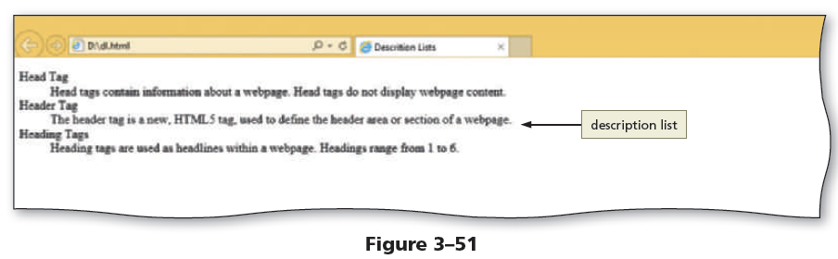
Adding Headings and Lists (continued)
The Figure 3-51 shows an example of a description list

Slide 39
To Validate Webpages
Perform the following steps to validate an HTML document:
Open a browser and type http://validator.w3.org/ in the address bar to display the W3C validator page
Tap or click the Validate by File Upload tab to display the Validate by File Upload tab information
Tap or click the Check button to send the document through the validator and display the validation results page

Slide 40
To Validate Webpages (continued)
Correct the errors if any, save the changes, and run the file through the validator again to revalidate the page
Perform the above steps to validate HTML pages and correct any errors
Close the browser, and then close the HTML text editor

Slide 41
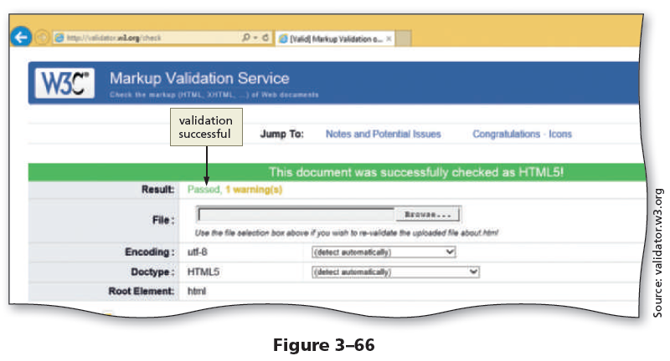
To Validate Webpages (continued 2)

Slide 42
WPDD202: Webpage Design & Development
Version 2 – 18th December 2015

Slide 43
Chapter E3
Website standards and accessibility

Slide 44
Learning Outcomes
Describe the evolution of the Internet and the Web
Explain the need for web standards
Describe universal design
Identify benefits of accessible web design
Identify reliable resources of information on the Web
Identify ethical use of the Web
Describe the purpose of web browsers and web servers
Identify Internet protocols
Define URIs and domain names
Describe XHTML and HTML

Slide 45
The Evolution of the Internet
Internet
Interconnected network of computer networks
ARPAnet
Advanced Research Project Agency
1969 – four computers connected
NSFnet
National Science Foundation
Use of the Internet was originally limited to government, research and academic use
1991 Commercial ban lifted

Slide 46
Reasons for Internet Growth in the 1990s
Removal of the ban on commercial activity
Development of the World Wide Web by Tim Berners-
Lee at CERN
Development of Mosaic, the first graphics-based web
browser at NCSA
Convergence of technologies:
Affordable personal computers with GUI Operating Systems
Affordable Internet service providers

Slide 47

The World Wide Web
The graphical user interface to information stored on some of the computers connected to the Internet.

Slide 48

Web Standards
and the W3C Consortium
W3C – World Wide Web Consortium
Develops recommendations and prototype technologies related to the Web
Produces specifications, called Recommendations,
in an effort to standardize web technologies
WAI – Web Accessibility Initiative

Slide 49
Web Accessibility
“The power of the Web is in its universality. Access by everyone regardless of disability is an essential aspect.” – Tim Berners-Lee
Accessible Websites
provide accommodations that help individuals
to individuals with visual, auditory, physical,
and neurological disabilities overcome barriers
WAI – Web Accessibility Initiative
Develops accessibility recommendations
WCAG 2.0
Web Content Accessibility Guidelines
http://www.w3.org/WAI/WCAG20/quickref/

Slide 50
Web Accessibility
Section 508 of the Rehabilitation Act
Requires that government agencies must give individuals with disabilities access to information technology that is comparable to the access available to others

Slide 51
Universal Design
“The design of products and environments to be usable by all people, to the greatest extent possible, without the need for adaptation or specialized design.”
– The Center for Universal Design
http://www.design.ncsu.edu/cud/about_ud/about_ud.htm

Slide 52

Information on the Web
I
Reliability and information
Evaluate the credibility of the site
Ethical use of information
Copyright and the Web

Slide 53
Summary
This chapter provided a brief overview of Internet, Web, and introductory networking concepts.

Slide 54

kent.edu.au Kent Institute Australia Pty. Ltd. ABN 49 003 577 302 ● CRICOS Code: 00161E ● RTO Code: 90458 ● TEQSA Provider Number: PRV12051

